Slide 1
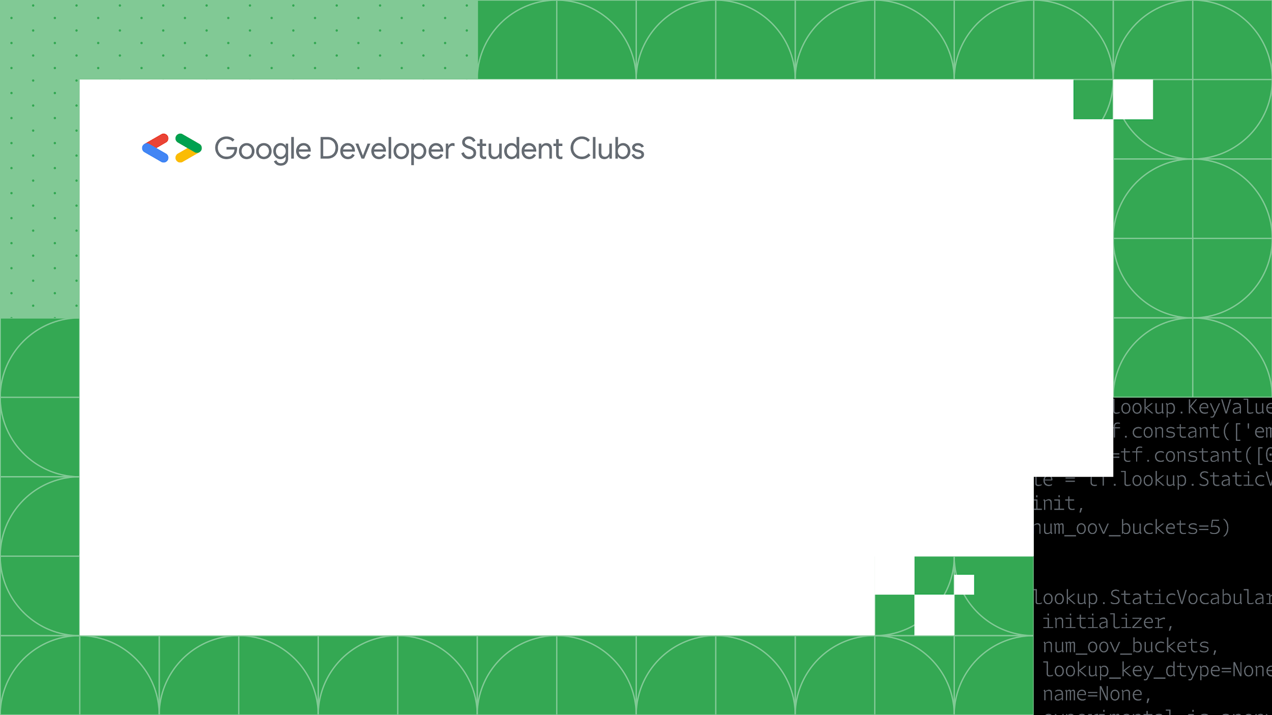
Welcome to Crafting Python Logics
A 2 days workshop by the Google Developer Student Club, The Islamia University of Bahawalpur

Slide 2

Welcome to Crafting Python Logics
Speakers :
Muhammad Abuzar
Huzaifa Nawaz
Anas Bajwa
A 2 days workshop by the Google Developer Student Club, The Islamia University of Bahawalpur

Slide 3
Welcome to Crafting Python Logics
Agenda :
Why Python?
Programming Fundamentals
Functional Programming
Data Types & Data Structures
Object Oriented Programming in Python
Intro to AI/ML with Tensorflow
Additional Resources
A 2 days workshop by the Google Developer Student Club, The Islamia University of Bahawalpur

Slide 4
Welcome to Crafting Python Logics
Module 1:
Introduction to Python Programming Language
History
Scope
Why Python?
A 2 days workshop by the Google Developer Student Club, The Islamia University of Bahawalpur

Slide 5

Introduction
Developed by Guido van Rossum
Easy to learn
Simple Syntax
Interpreted Language
Dynamically Typed

Slide 6
History
Development began in 1989 with a simplicity, readability and clean syntax philosophy.
First version released in 1991
Python3 released in 2008
Developers started building tools and libraries in Python in early 2000s
Tensorflow/Pytorch changed the game
Python becomes a key player in AI revolution

Slide 7
Scope
Data Sciences (Numpy, Pandas, Matplotlib, Seaborn)
AI/ML (Keras, Scikit Learn, Tensorflow, Pytorch, Theano)
Backend Web Frameworks (Django, Flask)
Game Development (Pygame)
Cloud Development and DevOps
Embedded systems and IoT with MicroPython

Slide 8
Scope
Python is one of the top 3 programming languages on GitHub along with Java and JavaScript
It has seen a 22% increase in usage in 2022 and a massive 51% increase in 2023
Django and Flask remain among the top web frameworks along with Express.js, Boot Spring and .NET Core

Slide 9
Welcome to Crafting Python Logics
Module 2 : Programming Fundamentals :
Syntax
Variable assignment
Loops
Data Types
Conditionals
A 2 days workshop by the Google Developer Student Club, The Islamia University of Bahawalpur

Slide 10
Welcome to Crafting Python Logics
Module 3:
How to define a function in Python?
What is Functional Programming Paradigm?
Functional parameters or arguments
A 2 days workshop by the Google Developer Student Club, The Islamia University of Bahawalpur

Slide 11
Welcome to Crafting Python Logics
Module 4:
What is Object Oriented Programming?
Difference between OOP & Functional Programming?
Classes & Objects
Four pillars of OOP
Is Python an Object Oriented Language?
A 2 days workshop by the Google Developer Student Club, The Islamia University of Bahawalpur

Slide 12
Welcome to Crafting Python Logics
Module 5:
What are libraries?
Difference between a library and framework?
Intro to Numpy, Pandas and Matplotlib
What is Tensorflow
A 2 days workshop by the Google Developer Student Club, The Islamia University of Bahawalpur

Slide 13
Module 6 : AI
Intelligence is the ability to make logic, reasoning, adapt to different environments & solve problems.
Humans and other organisms have Organic Intelligence while the intelligence that we induce in computer systems to solve problems like humans do, is called Artificial Intelligence.
AI Systems learn just like us, we learn through experiments, results and observations. Machines learn through those results transformed into digital data.
Data is the new oil.
AI models learn through data

Slide 14
DS vs AI vs ML
Data Science is a field of Computer Sciences in which we manipulate, preprocess, transform, use and store data.
Since AI involves using that data so AI is a subfield of Data Sciences.
Machine learning refers to using statistical algorithms to learn from data and generalize to unseen data.
Machine Learning uses statistical algorithms while Deep Learning uses Artificial Neural Networks just like the ones found in our brain and the entire nervous system of every organism on the planet.

Slide 15
Classification vs Regression
There are basically 2 types of ML tasks :
1. Classification
2. Regression
Classification : differentiate b/w 2 or more classes; e.g differentiate between spam or non-spam emails, classify b/w images of dogs & cats
Regression : predict a value, can be any number; e.g given a car’s features, find its fuel average or estimate the price of a house based on its attributes like num. of rooms, area in sq. ft etc

Slide 16
Any Questions ?

